Slide 1

EDUCARE SYSTEM
COLLEGE: Shri Shambhubhai V. Patel College of Computer Science and Business Management
PRESENTED BY:
VAIBHAV TALAVIYA (1868)
JIL SUTARIYA (1865)
JAY TALAVIYA (1867)
GUIDED BY:
Prof. Binal naik

Slide 2










OUTLINE
Introduction
Scope
Goal
User Characteristics
Process Model
Functionalities
System Requirement
Schedule
User Interface Design (UID)

Slide 3

INTRODUCTION
The E- Learning system was based on learning electronically.
The E- Learning is used world wide web has provided us with easy access to information and knowledge.
It bridges the gap between a teacher and a student in different ways.
It is store house of education, information, communication training, knowledge and performance management.

Slide 4

SCOPE
This system provide better management for learning online with the help of best tutor from world wild, it will also help to learn at home or no matter where they are but they can learn any time any were.
We are going to develop the proposed system with objective to eliminate the cost of fees of privet coaching centre or private institute

Slide 5


GOALS
EDUCARE learning system is specially designed to spread more knowledge from world so everyone can learn easily no matter where they are.
EDUCARE allow you to learn 24 * 7.
To Improve the Education system and students skills

Slide 6

HARDWARE And Software REQUIREMENTS
Client side
Hardware Requirements
Processor: Intel Core i3
RAM: 1GB
Hard disk: 15 GB
Software Requirements
Operating System: Any operating system will do.
NOTE: This website does not require any specific one.
INTERNET: Internet connection is required because website is working online.
BROWSER: Chrome (Recommended), you can use any latest browser.

Slide 7

HARDWARE And Software REQUIREMENTS
Server side
Hardware Requirements
Processor: Intel Core i5
RAM: 8GB (recommend)
Software Requirements
Operating System: Windows 10
Front End: HTML
Back End: Php, MYSQL

Slide 8







Tools are used
Front End Tools
Back End Tools
Framework

Slide 9

Users of system
Visitor
User
Tutors
Classes
Admin

Slide 10

All term & Condition
Terms & conditions for "Refund Module“
If a student participates in the entire course or has downloaded the course before the refund was requested, the refund might be not approved
We do NOT offer refunds for courses after the 15 day refund period
Students are not eligible for refund on the same course again
Terms & conditions for "Certificate module“
Complete course
Attend all test with minimum 65% score
Terms & conditions for "Tutor Coupon Module"
Tutor can create coupon for their courses only
Tutor can not provide 100% discount coupon
Tutor can not create coupon beyond their sharing amount
If tutor has create any coupon then discount will be calculated from tutor sharing amount if admin has create any coupon then discount will be calculated from tutor sharing amount

Slide 11

Benefits of system
Traditional Learning system limited with the classrooms and schools, private institute But in E-learning system will used from anywhere in the word.
Traditional Learning was limited with particular area But E-learning will no limit so All latest courser are learn any students.
E learning system was 24/7 so any one learn any topic
The E learning system will have online Exam and the student will get the result and the system will help to improved their education.

Slide 12
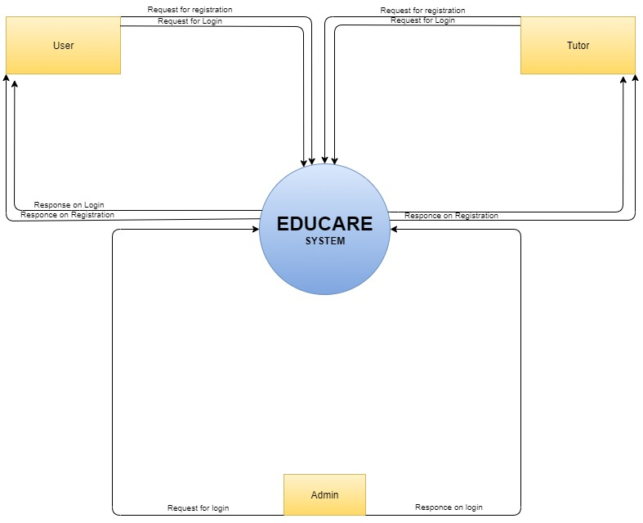
Data flow Diagram
Context level - DFD
E-LEARNING SYSTEM

Slide 13
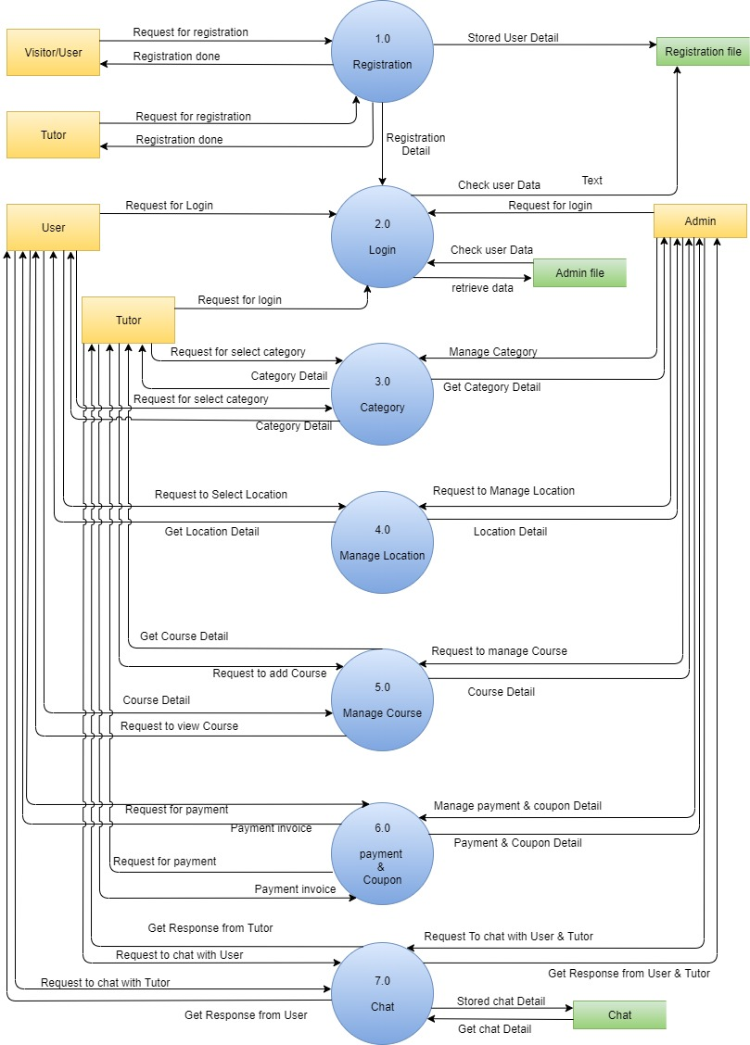
zero level dfd

Slide 14
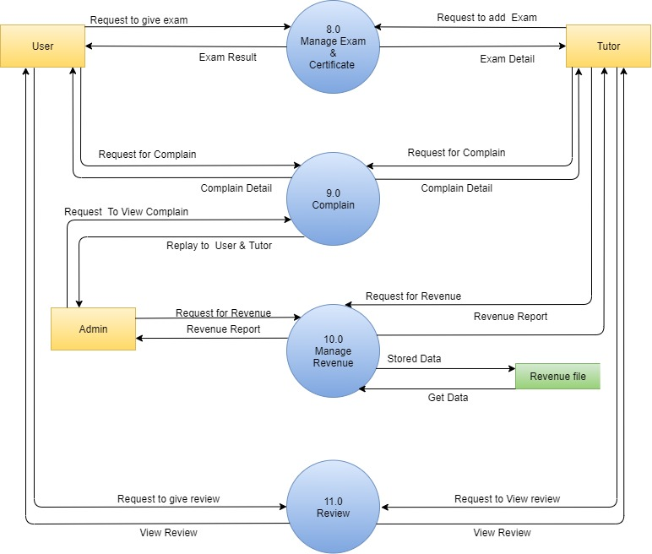
zero level dfd

Slide 15
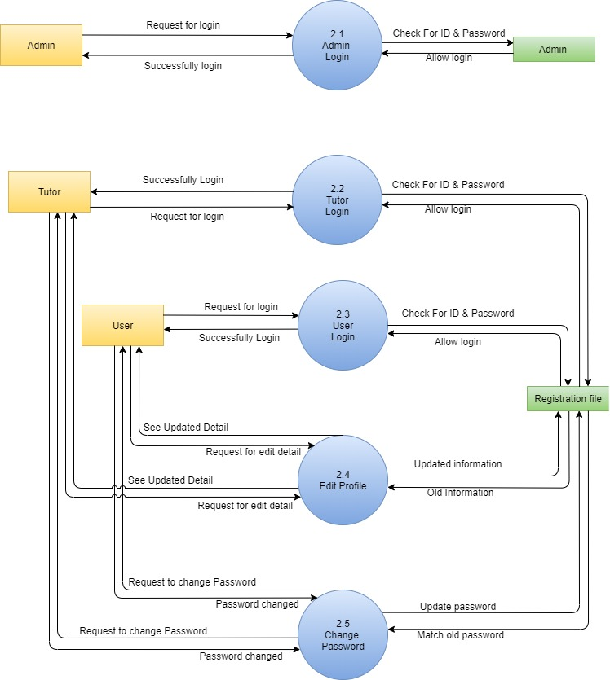
First level of process
2.0
LOGIN
PROCESS

Slide 16
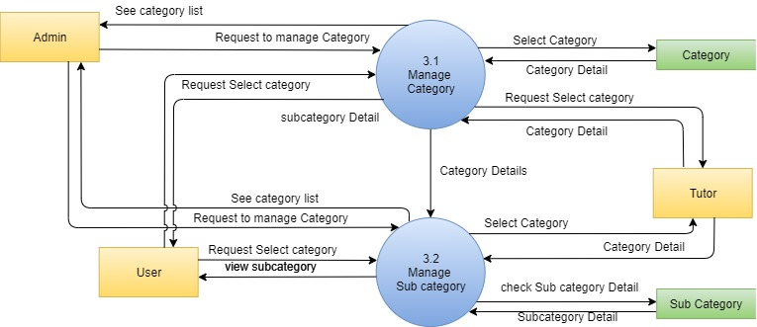
First level of process
3.0
CATEGORY
PROCESS

Slide 17
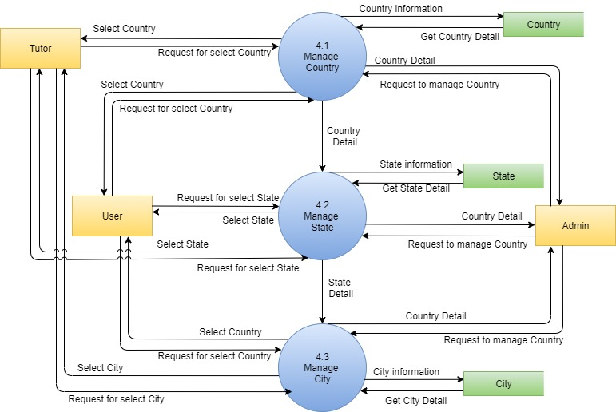
First level of process
4.0
LOCATION
PROCESS

Slide 18
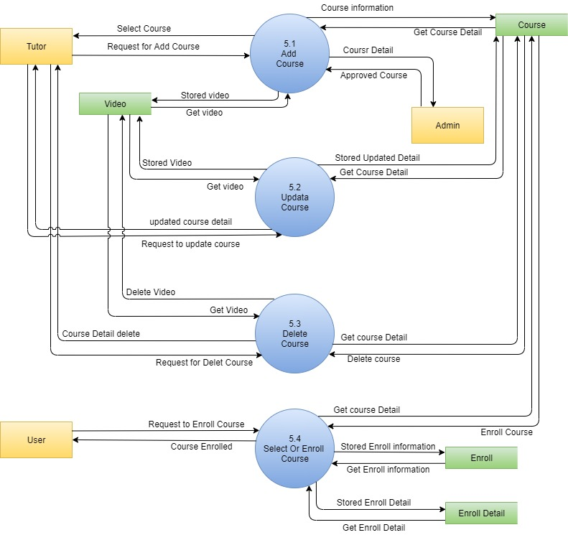
First level of process
5.0
COURSE
PROCESS

Slide 19
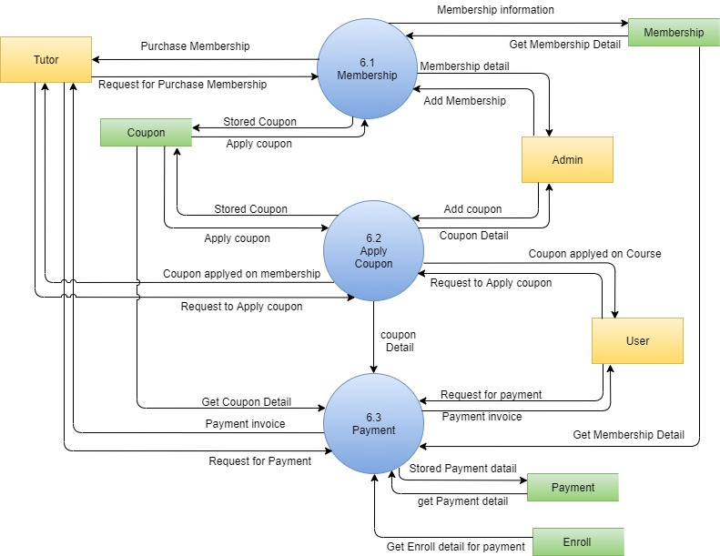
First level of process
6.0
PAYMENT
&
COUPON
PROCESS

Slide 20
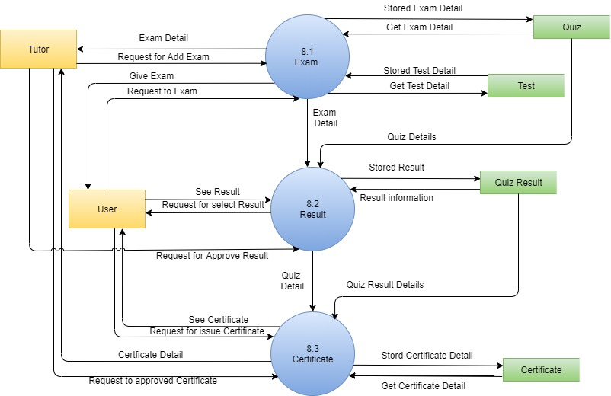
First level of process
8.0
EXAM &
CERTIFICATE
PROCESS

Slide 21
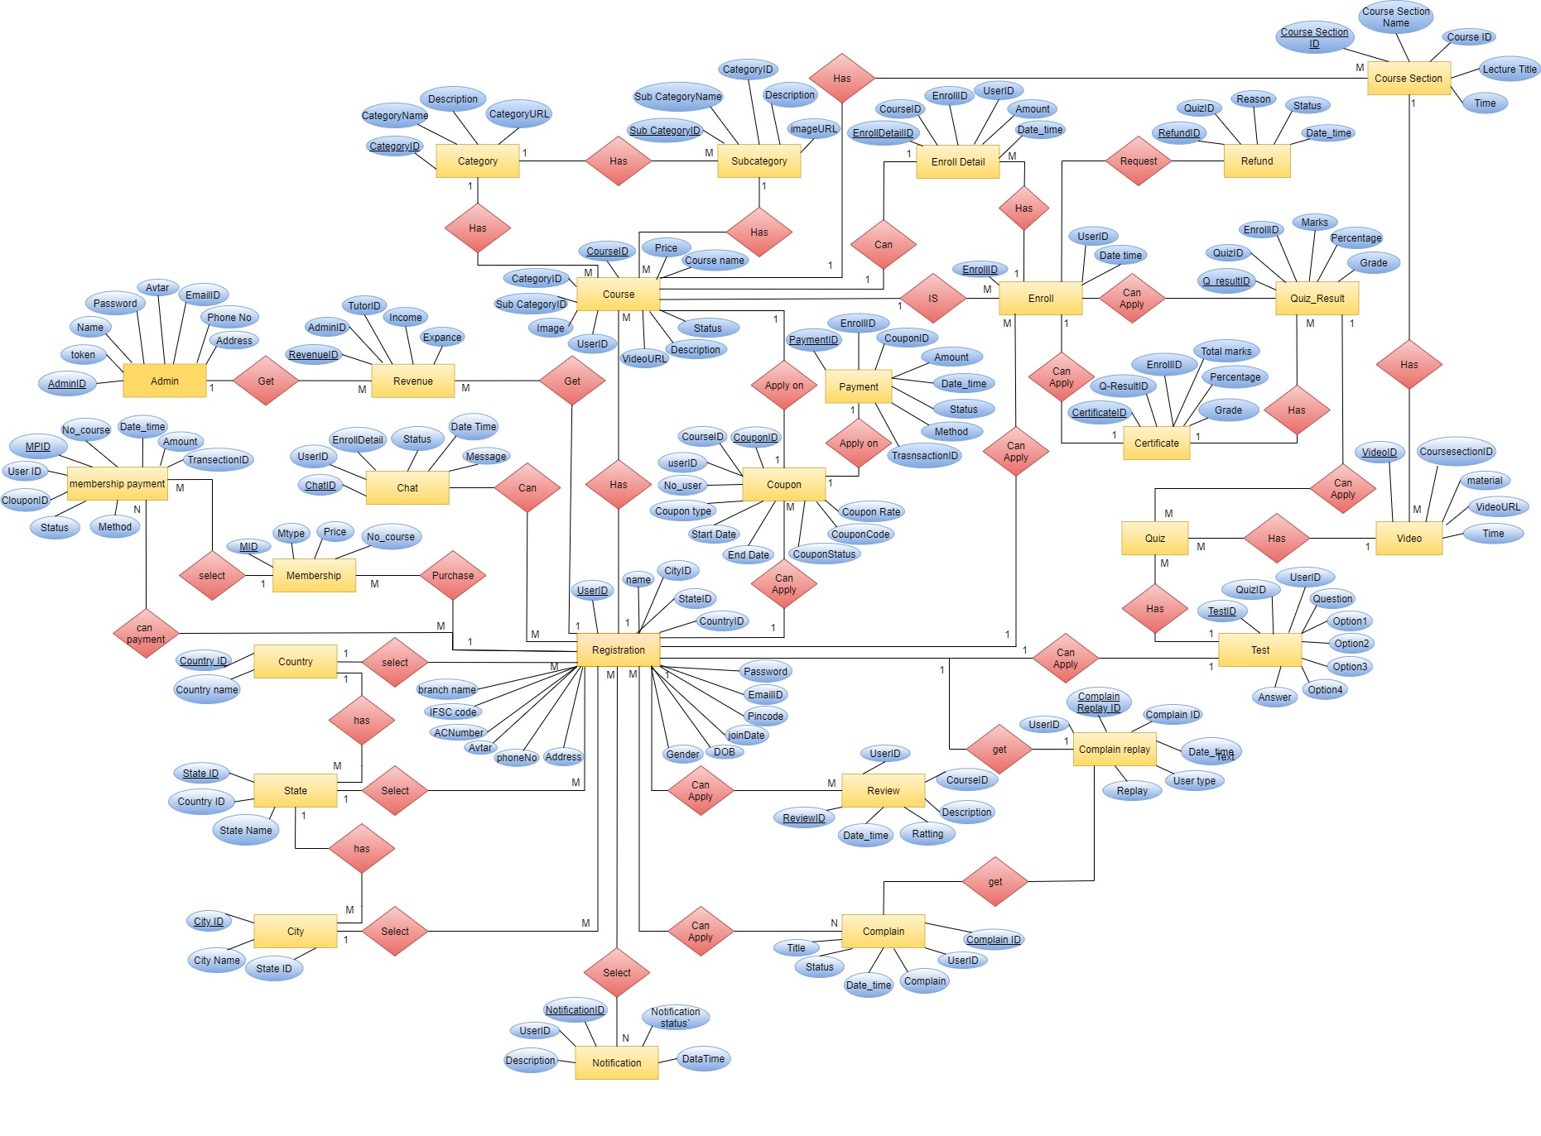

ER Diagram

Slide 22

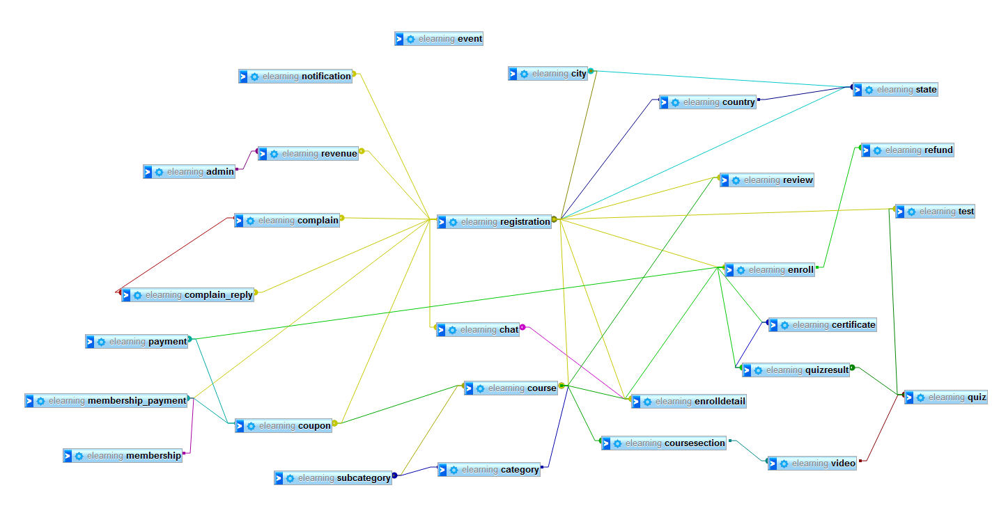
Database Design

Slide 23
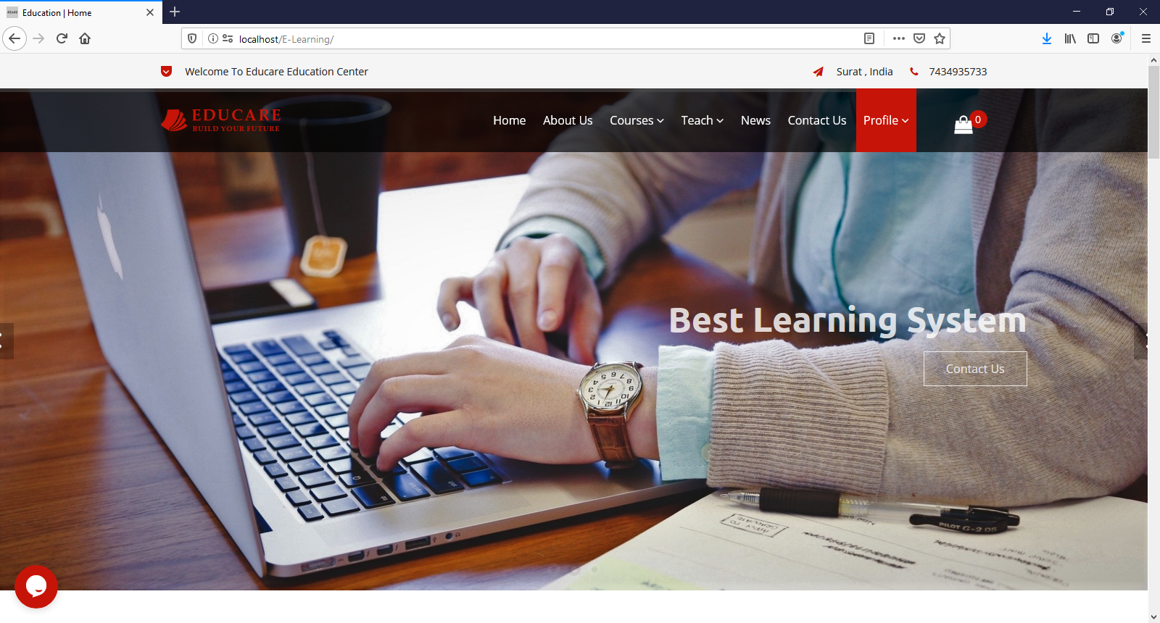

user HOMEPAGE
user interface

Slide 24
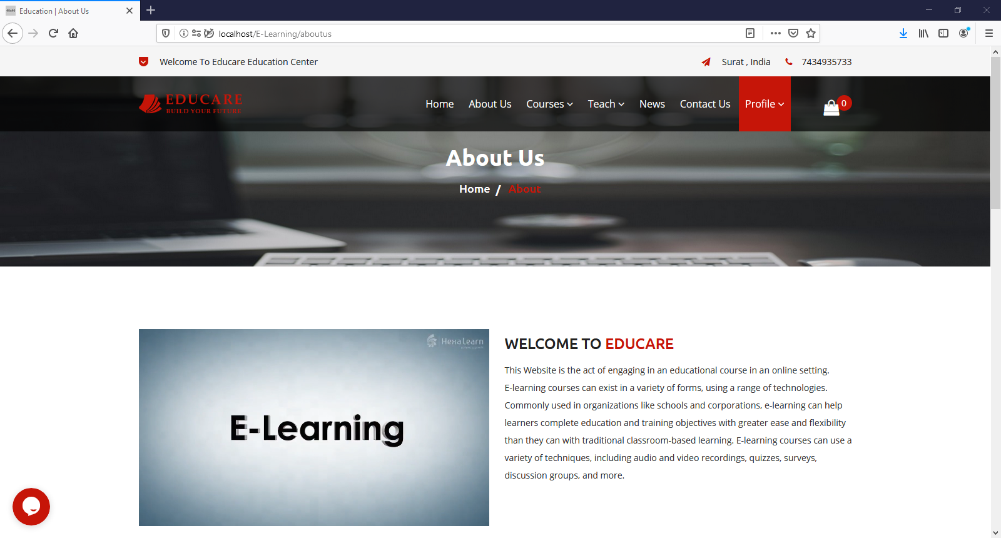
ABOUT US
user interface

Slide 25
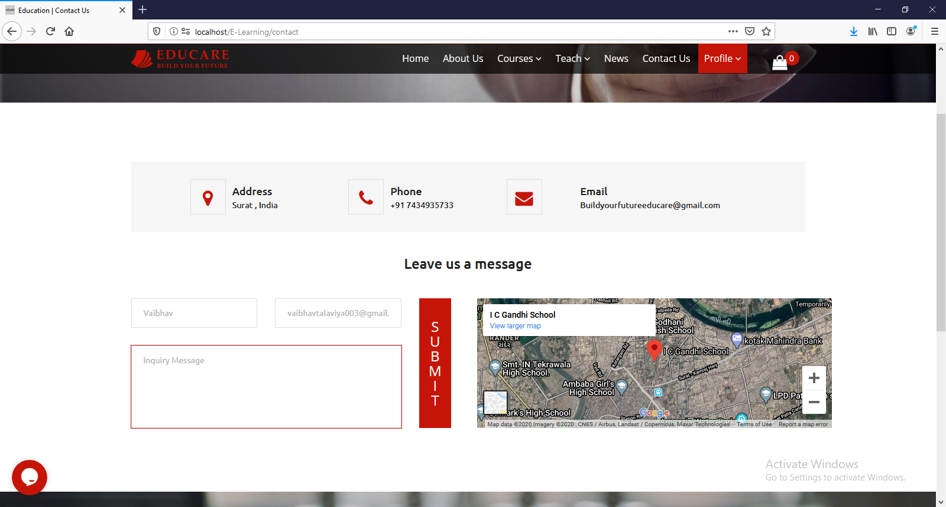
CONTACT US
user interface

Slide 26
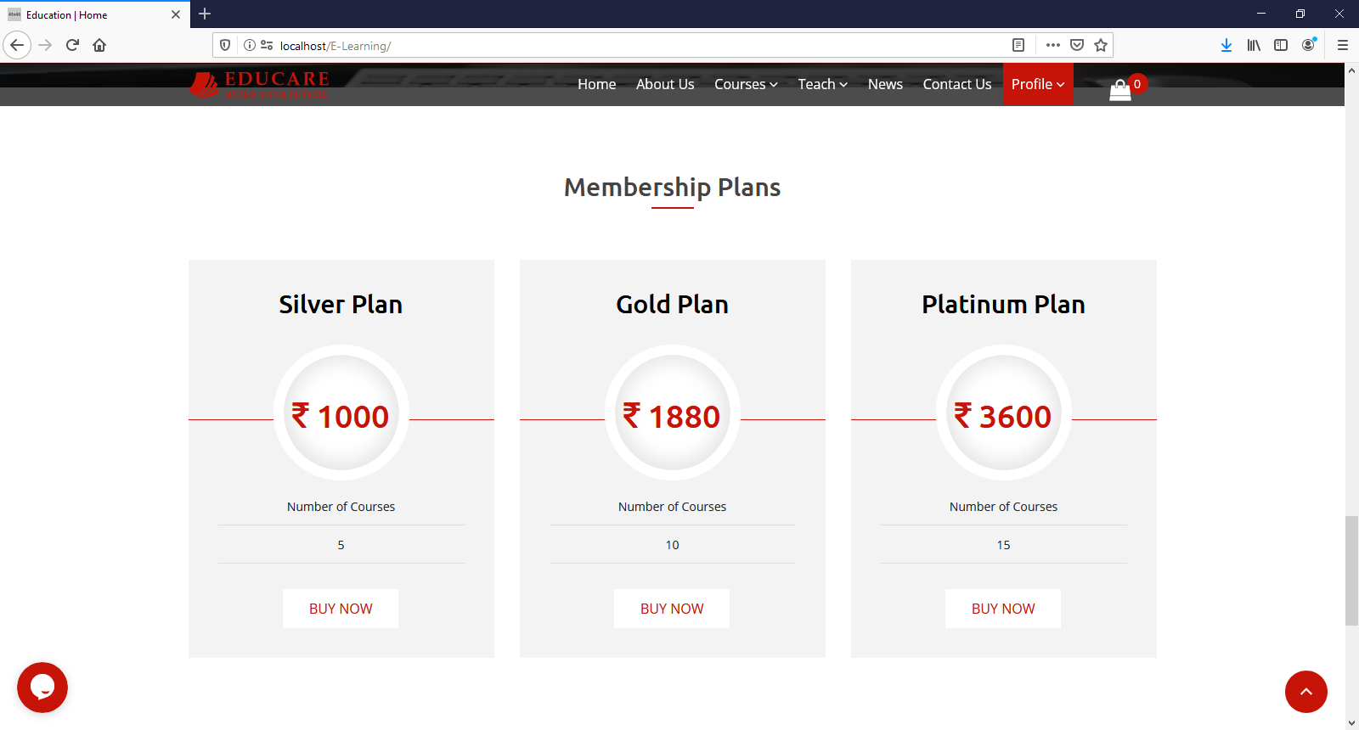
MEMBERSHIP PLAN
user interface

Slide 27
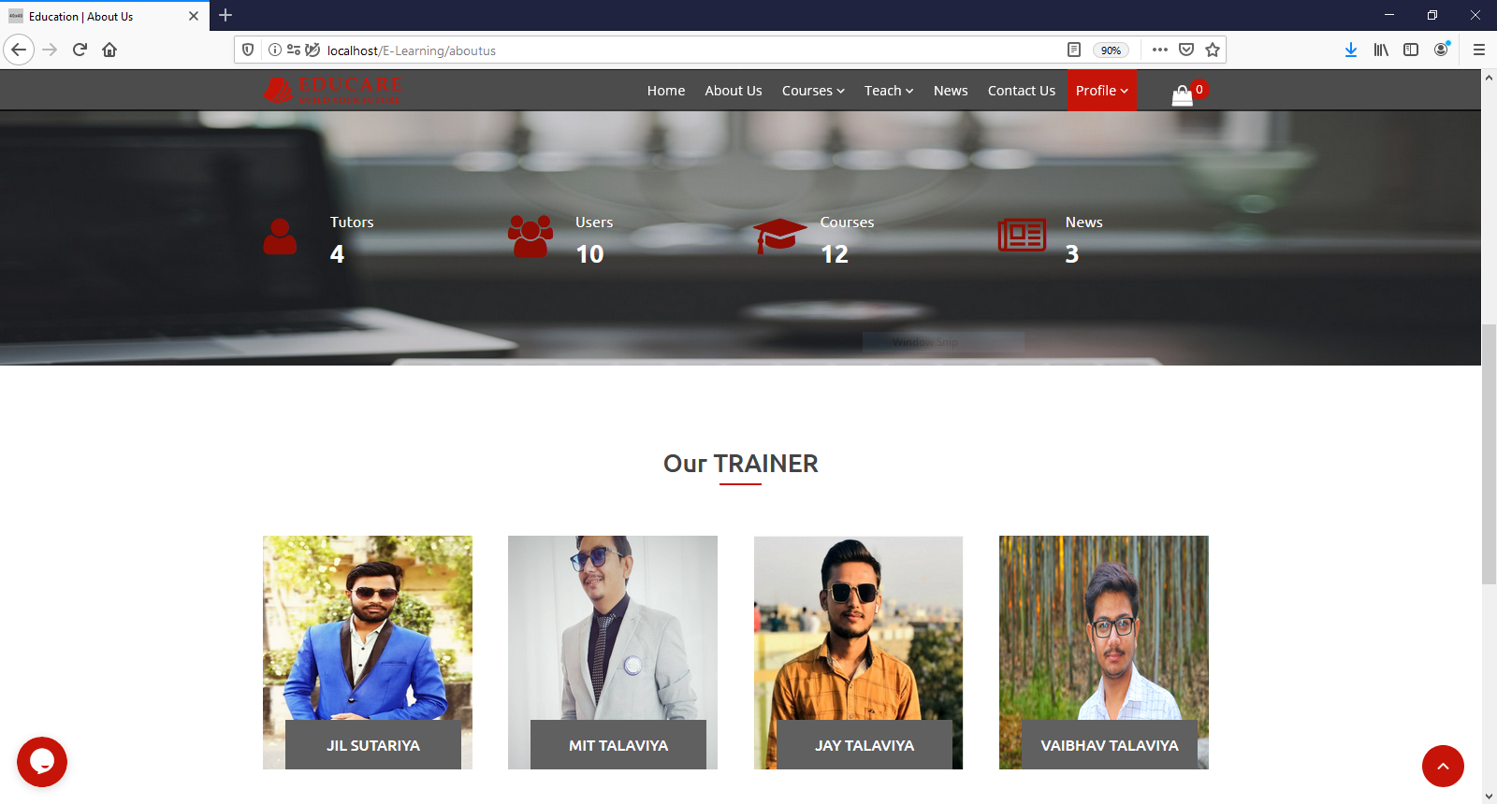
LIST of TRAINERS
user interface

Slide 28
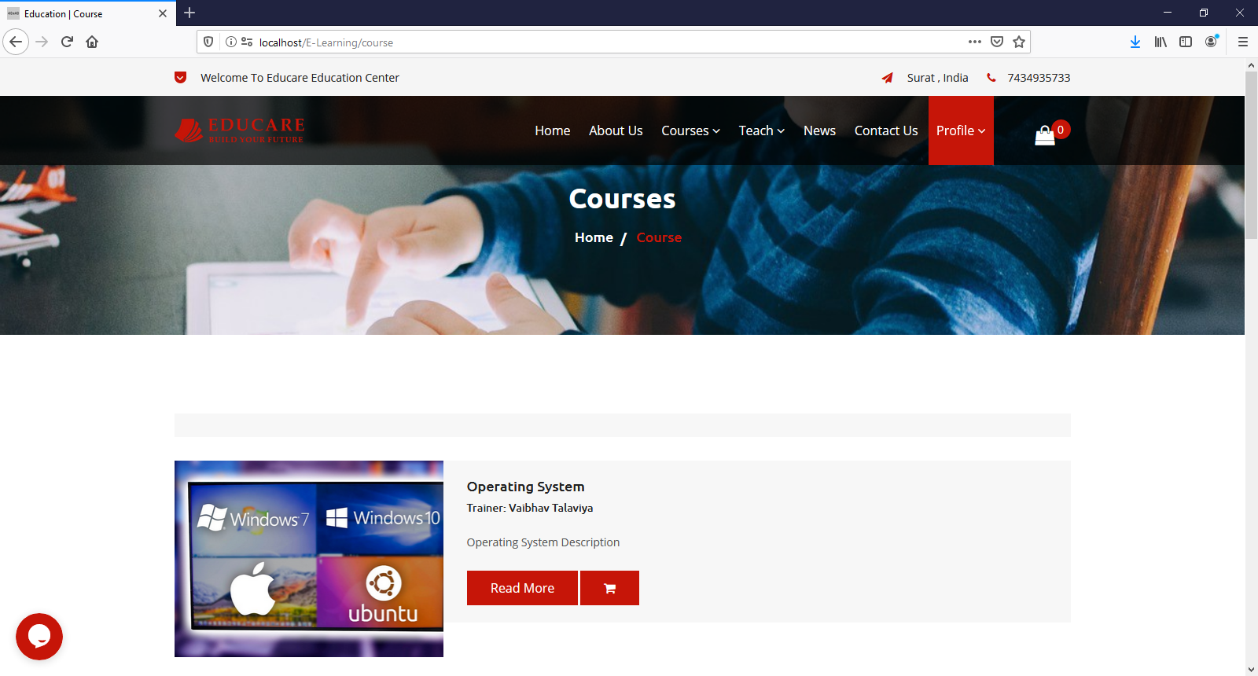
COURSE LISTING user sIDE
user interface

Slide 29
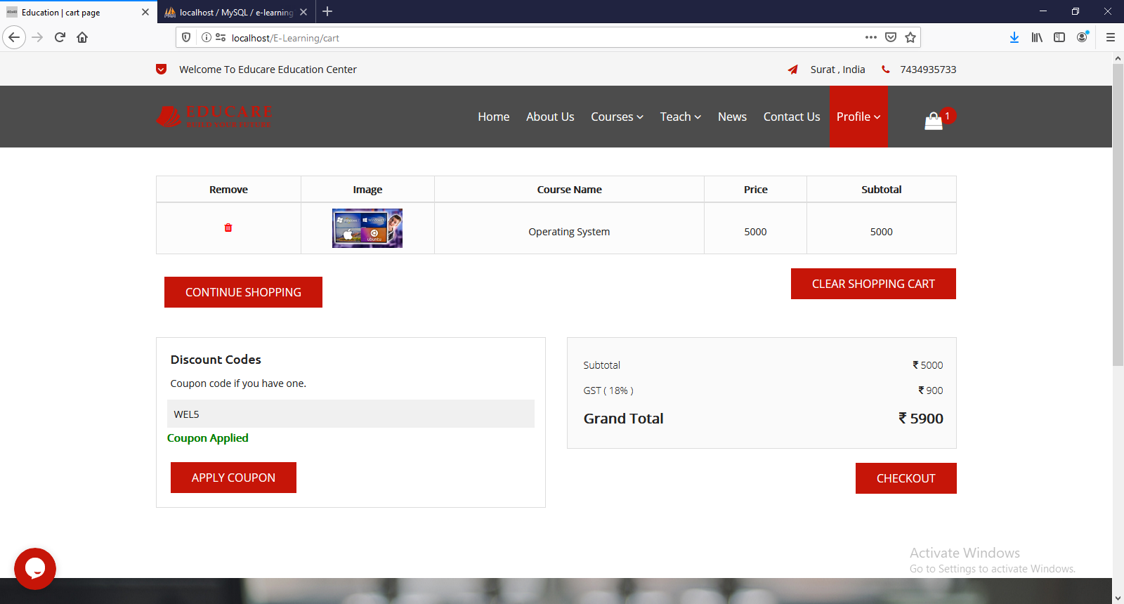
CART DETAIL
user interface

Slide 30
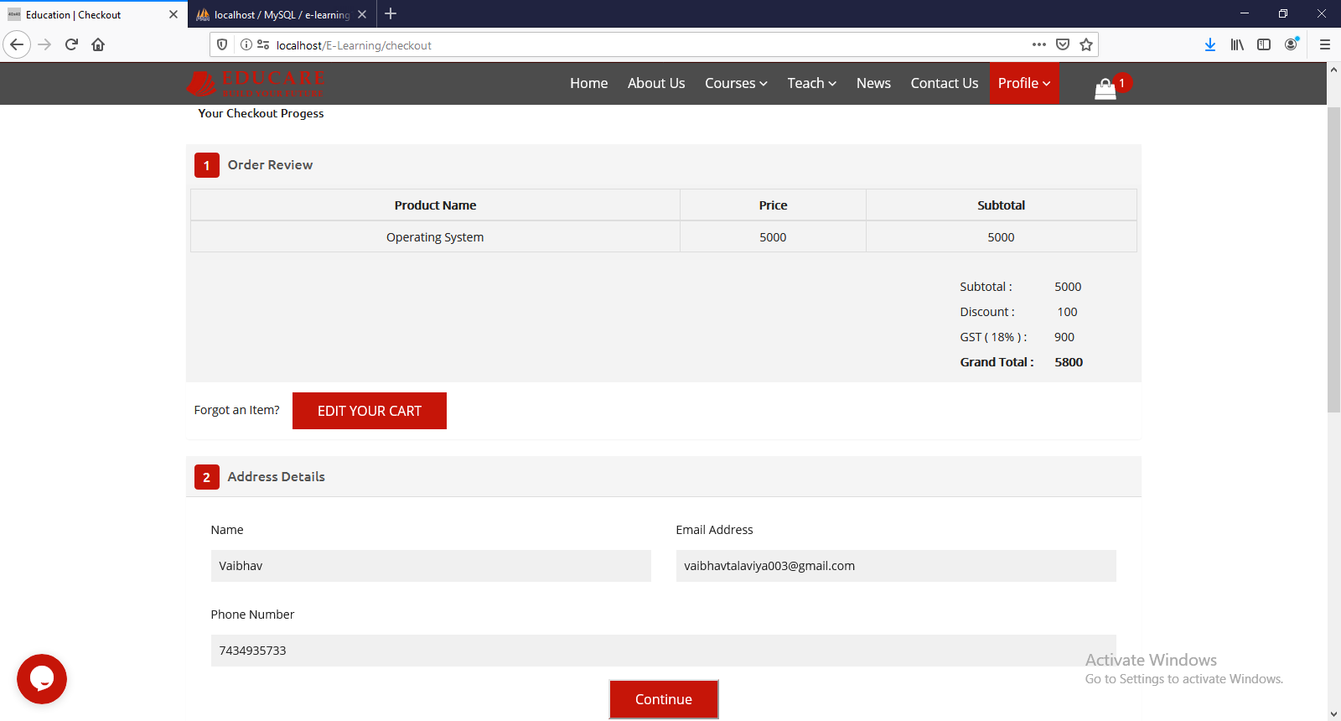
CHECKOUT DETAIL
user interface

Slide 31
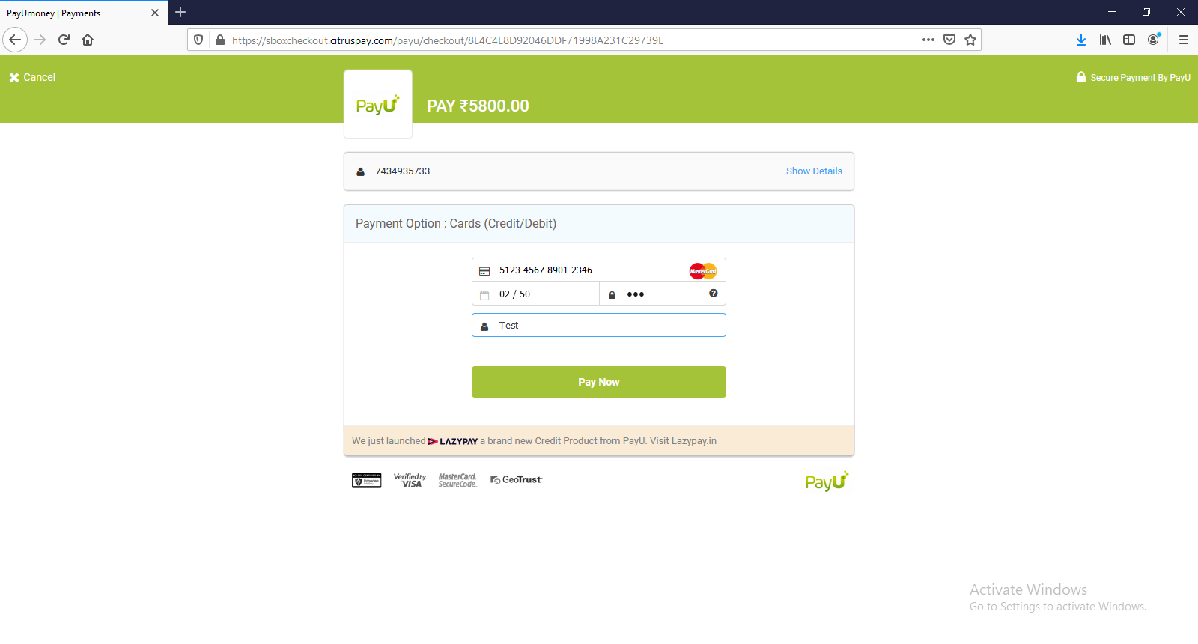
PAYMENT PAGE
user interface

Slide 32
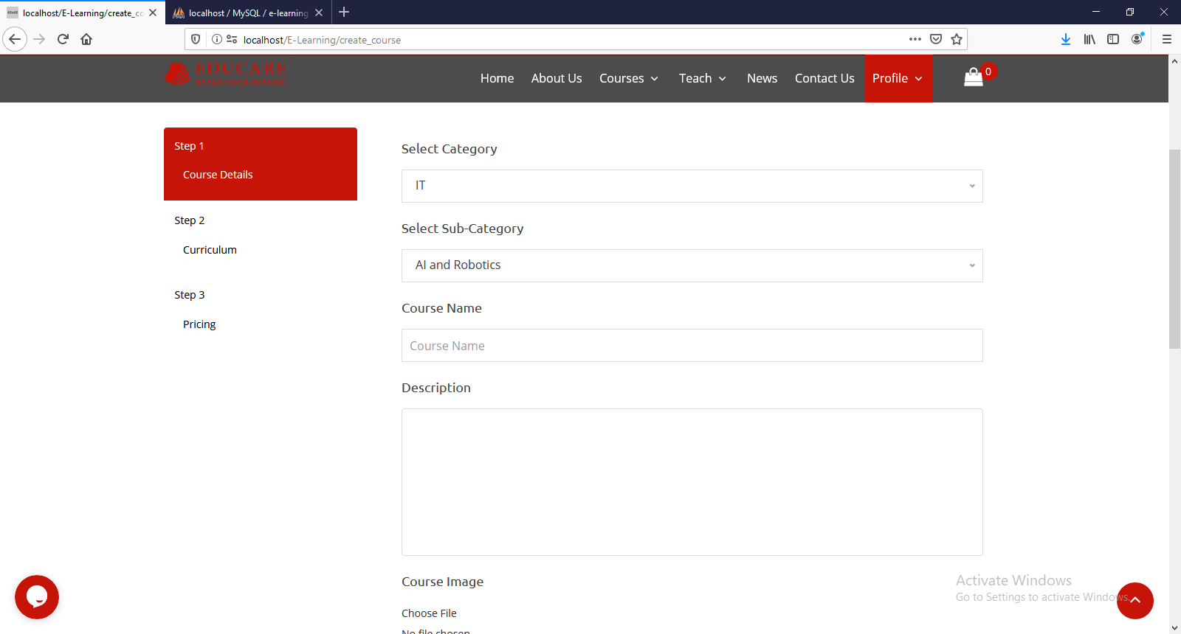
Create course step: 1
user interface

Slide 33
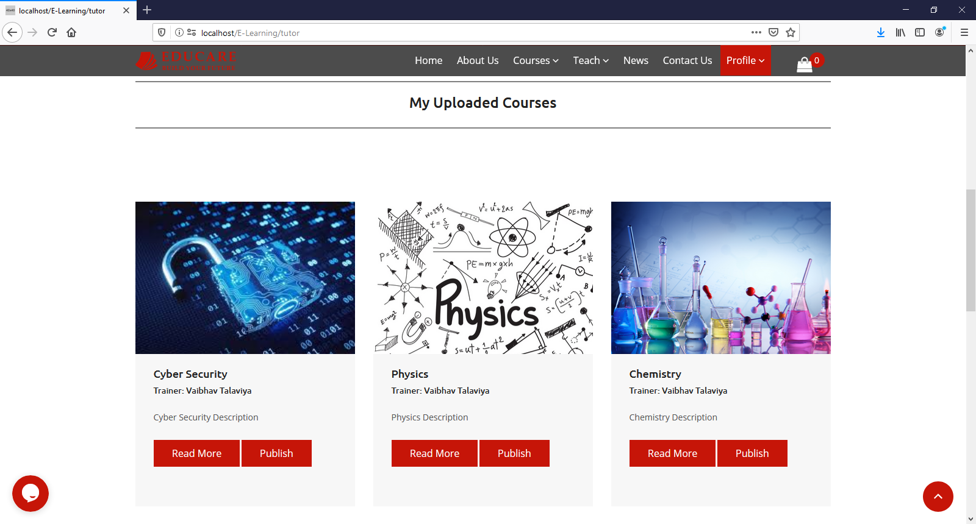
LIST OF COURSE UPLOAD BY TUTOR
user interface

Slide 34
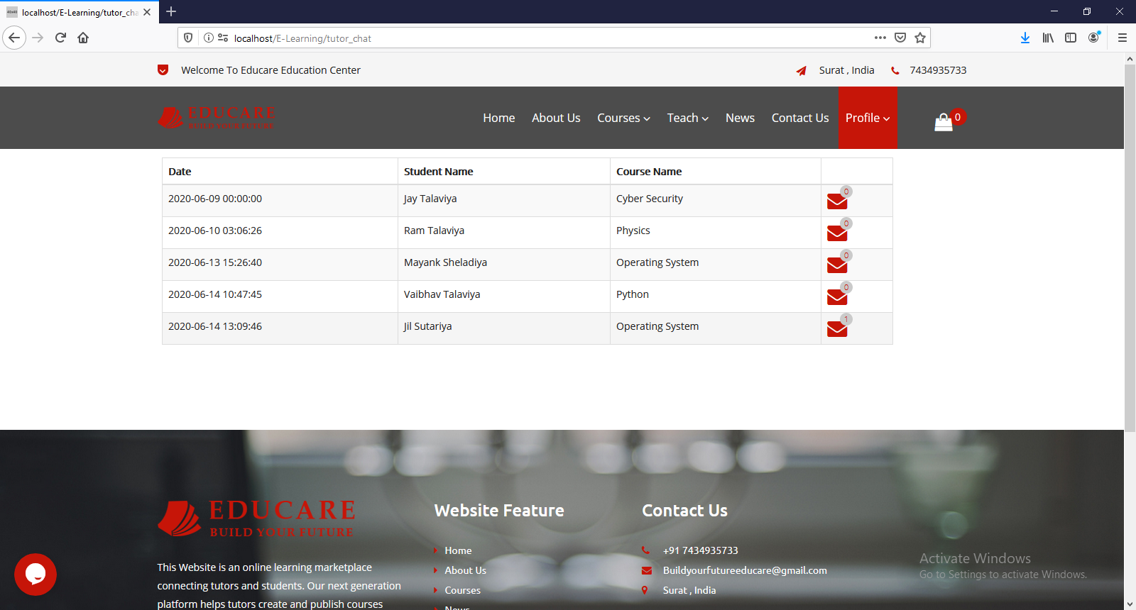
Tutor discuss with student
user interface

Slide 35
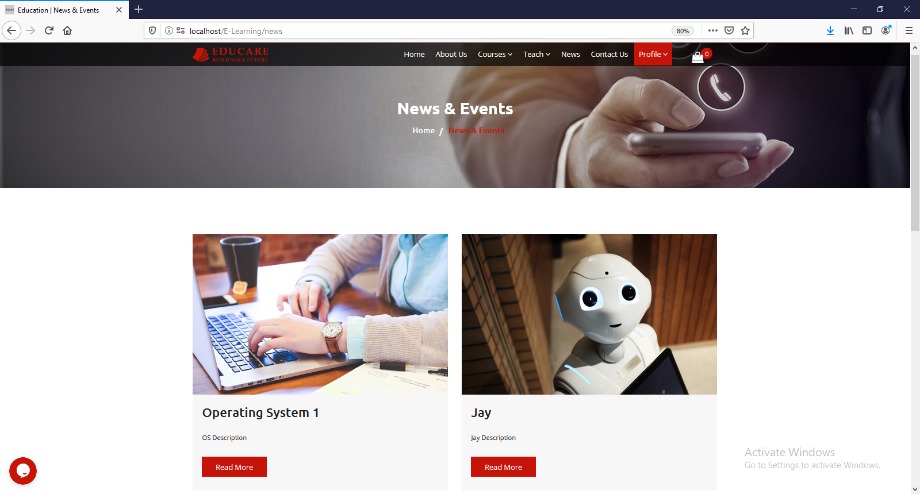
NEWS & EVENTS
user interface

Slide 36
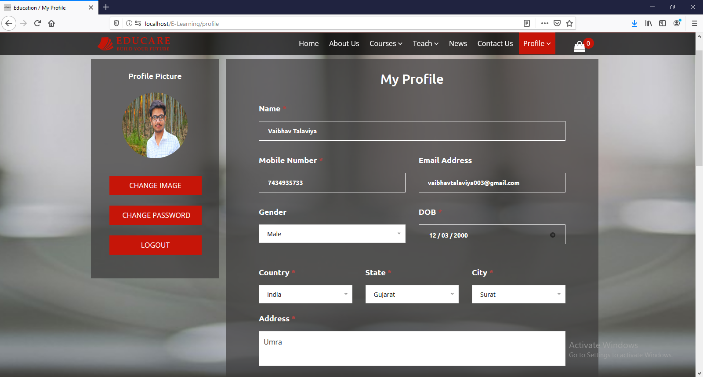
USER PROFILE PAGE
user interface

Slide 37
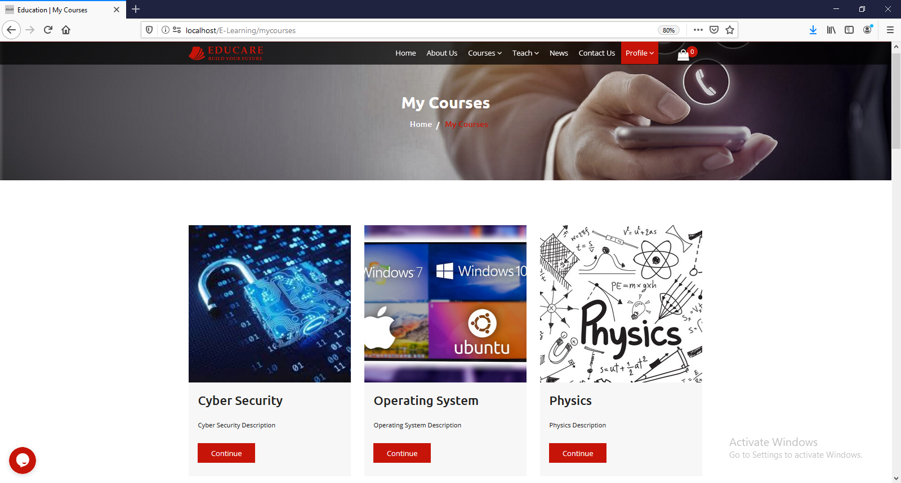
USER PURCHASED COURSE
user interface

Slide 38
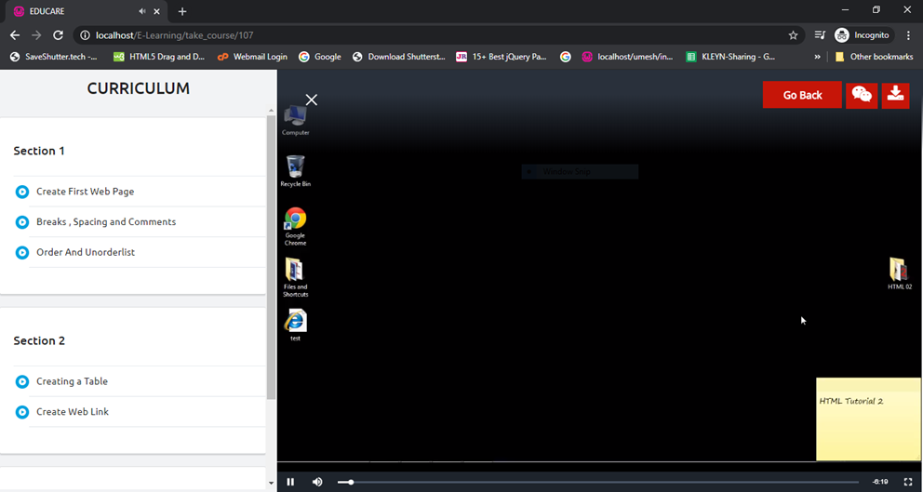
USER Can View Video
user interface

Slide 39
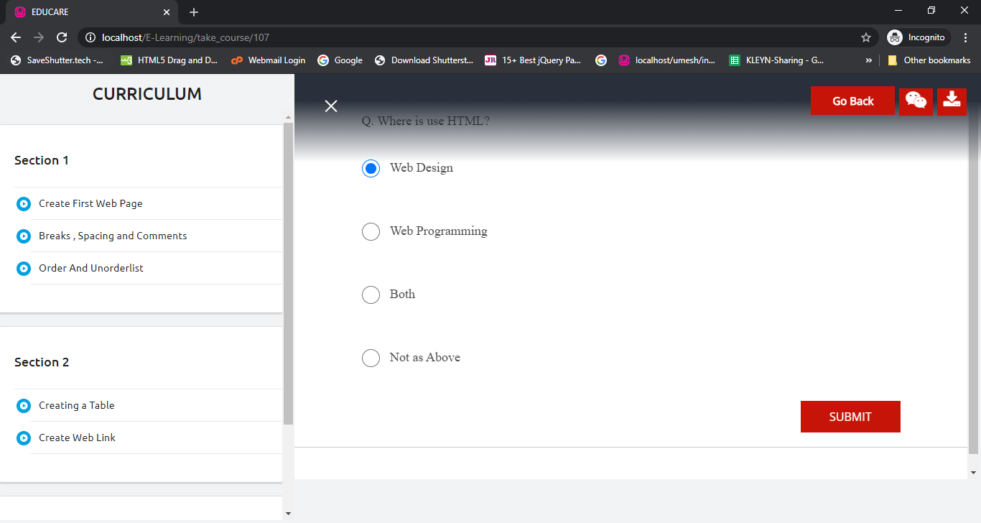
USER Give exam After View Video
user interface

Slide 40
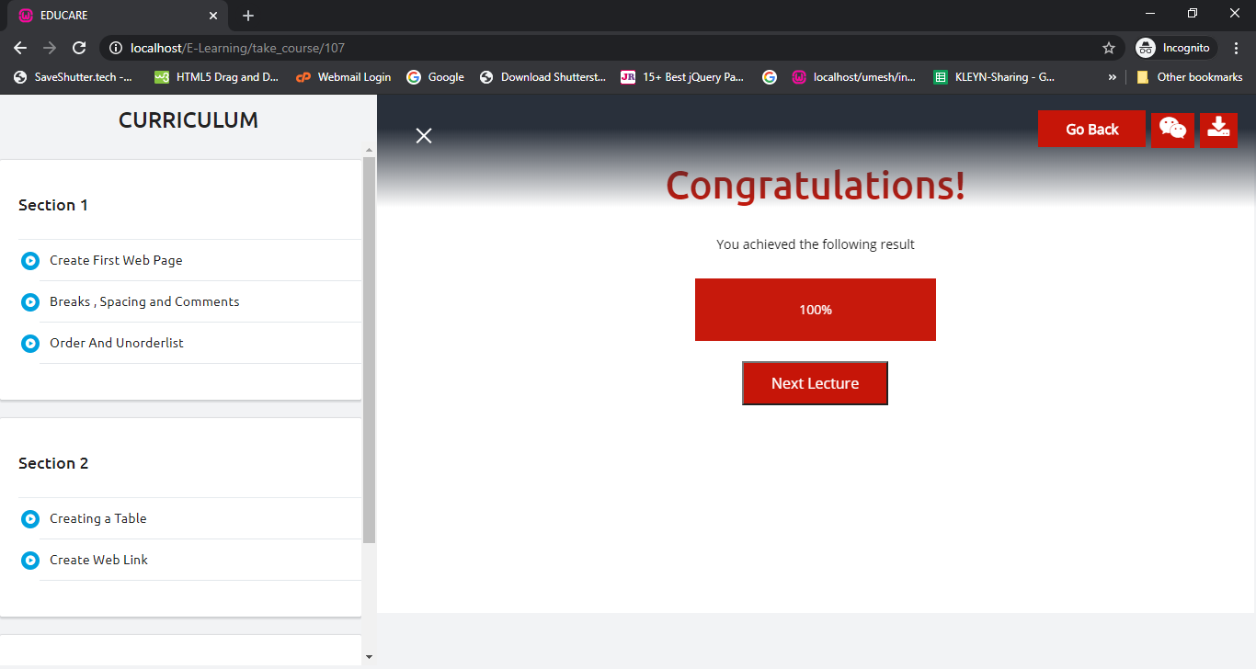
USER will See exam Result After Exam
user interface

Slide 41
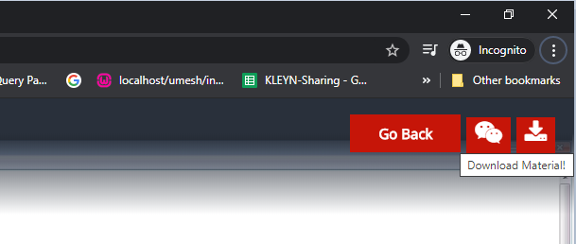
USER will Download Materials
user interface

Slide 42
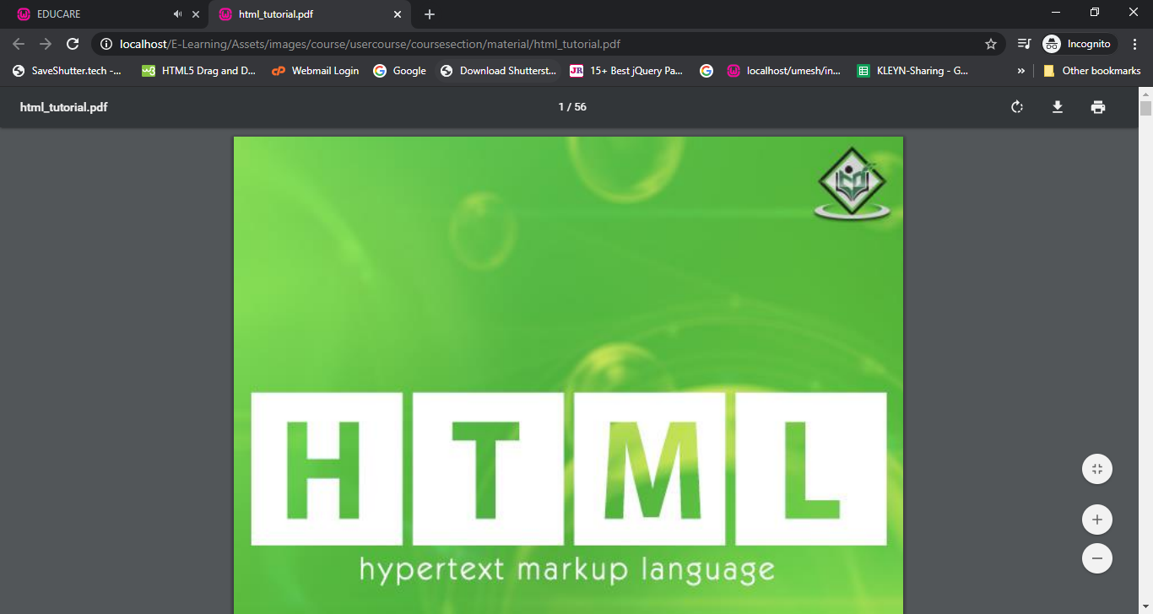
User read Downloaded Materials
user interface

Slide 43
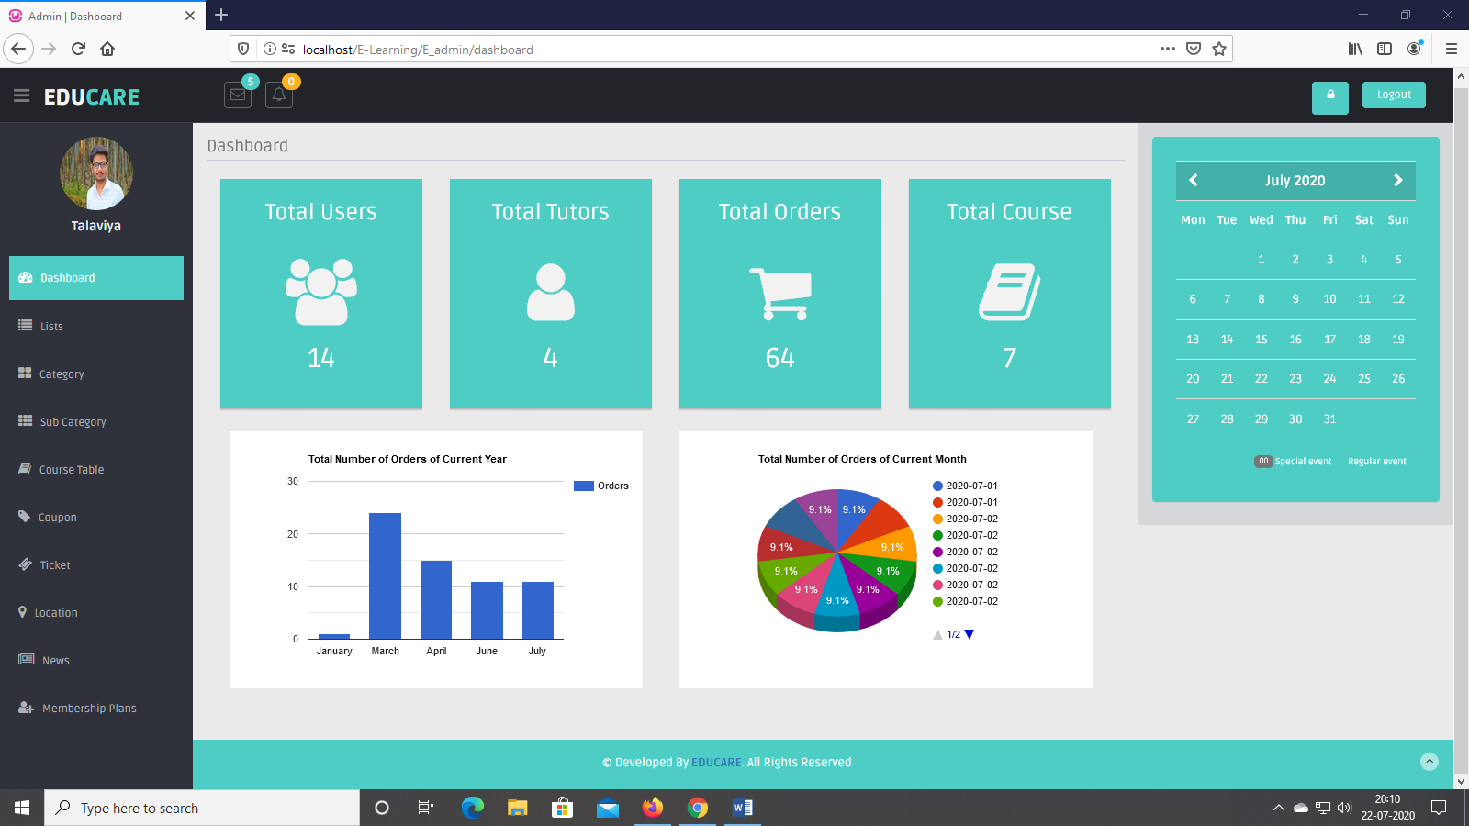
Admin Dashboard
user interface

Slide 44
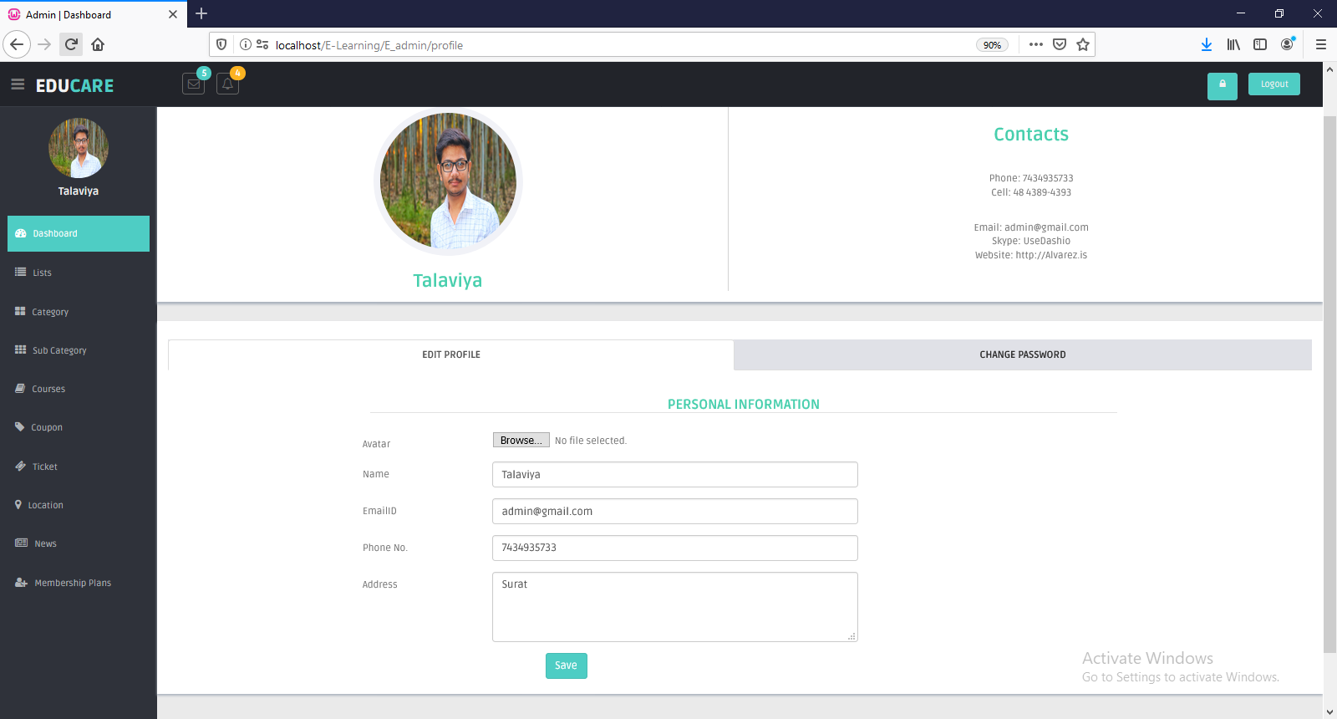
Admin PROFILE
user interface

Slide 45
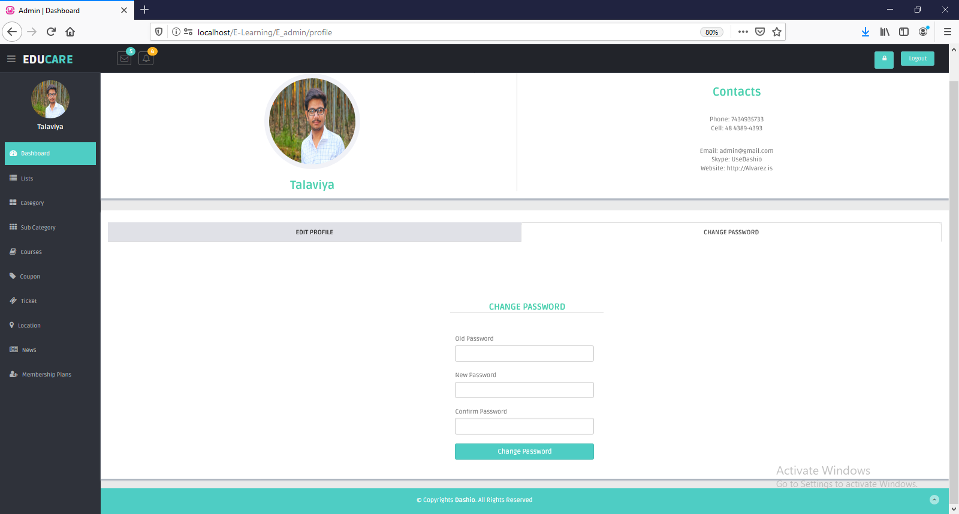
Admin Change Password
user interface

Slide 46
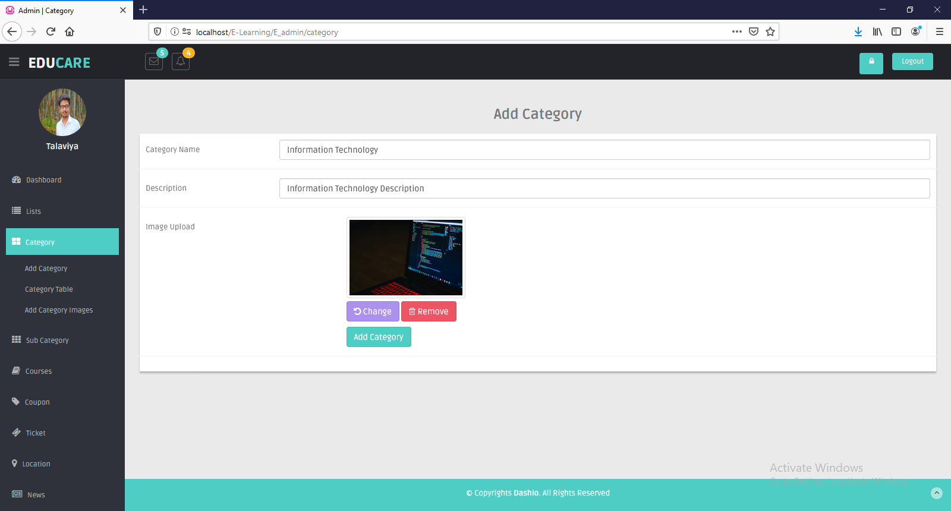
Admin SIDE ADD NEW CATEGORY
user interface

Slide 47
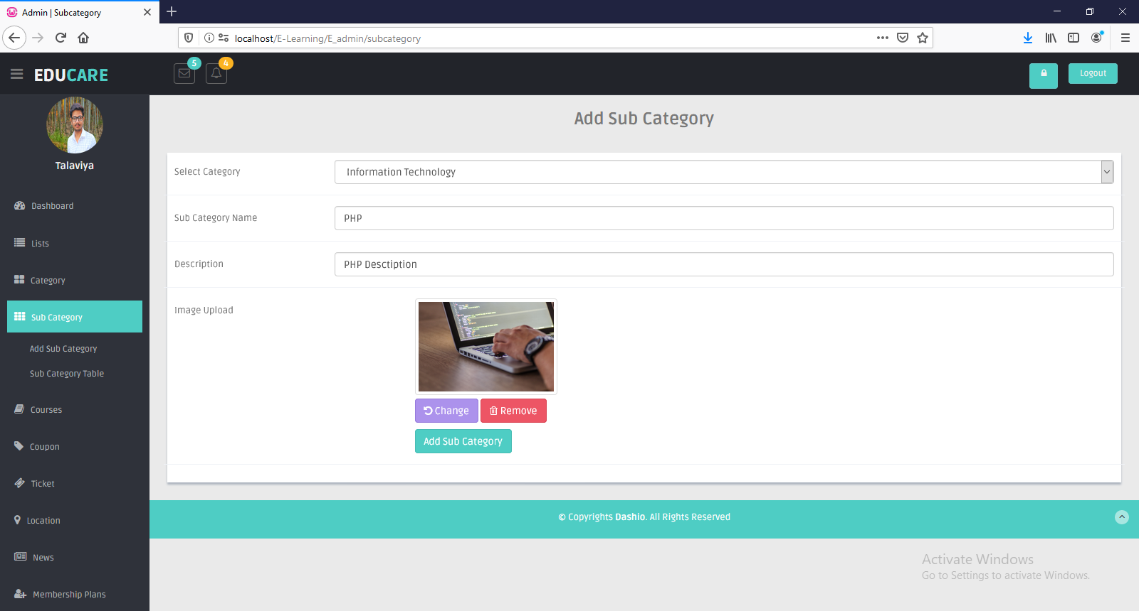
Admin SIDE ADD NEW SUBCATEGORY
user interface

Slide 48
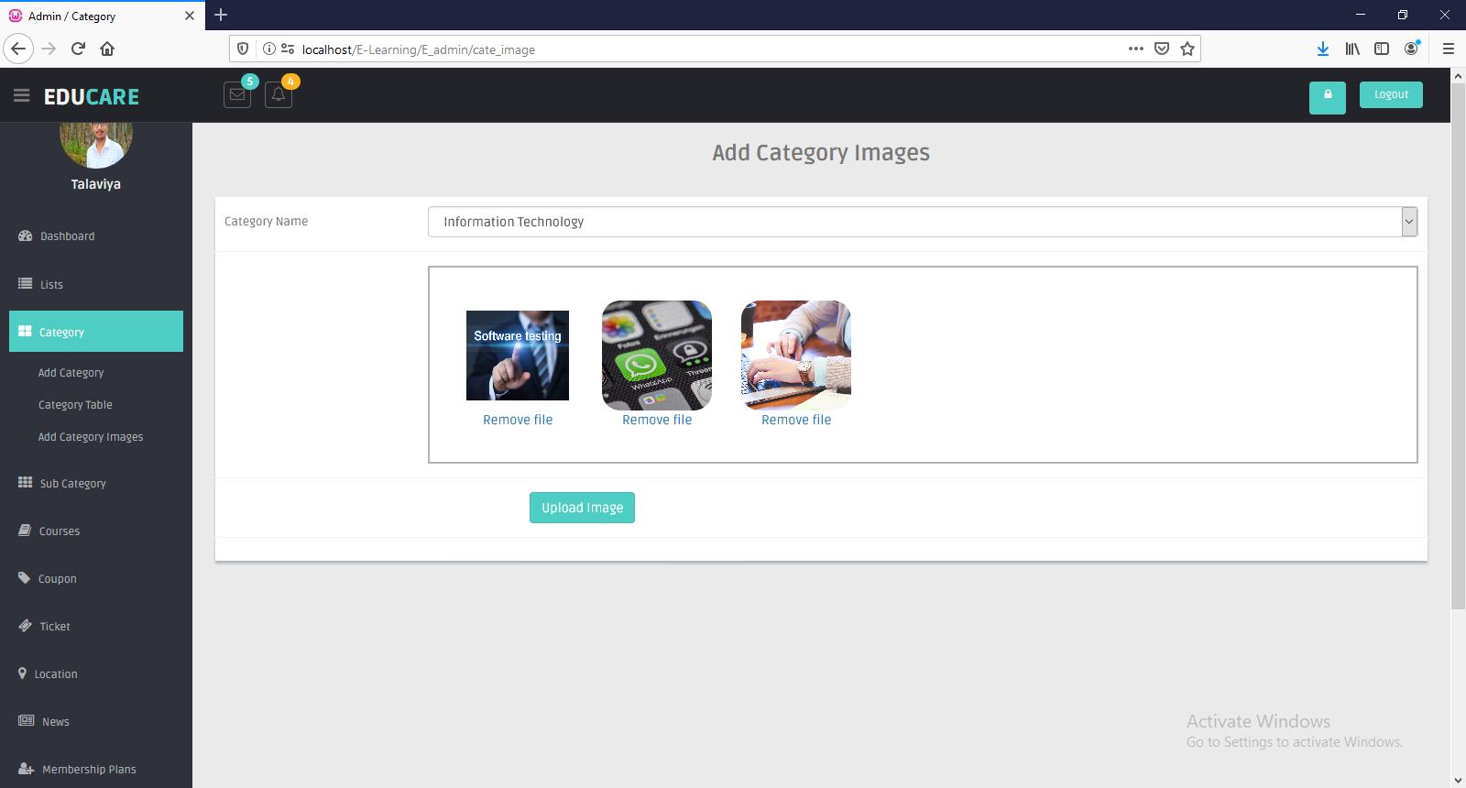
Admin SIDE ADD MULTIPLE IMAGES OF CATEGORY
user interface

Slide 49
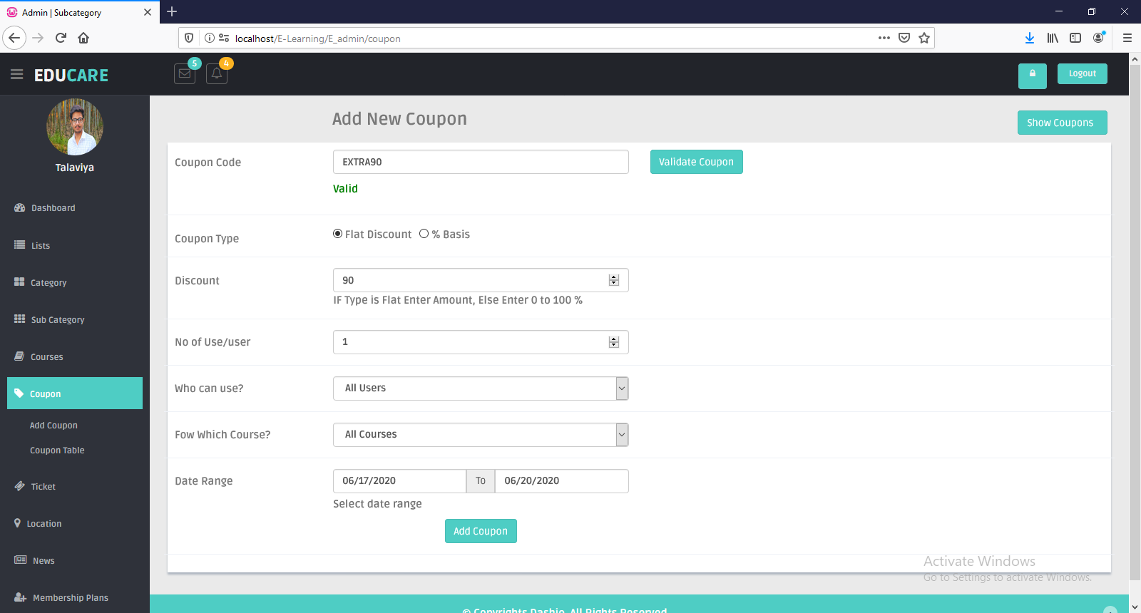
Admin CAN ADD COUPON
user interface

Slide 50
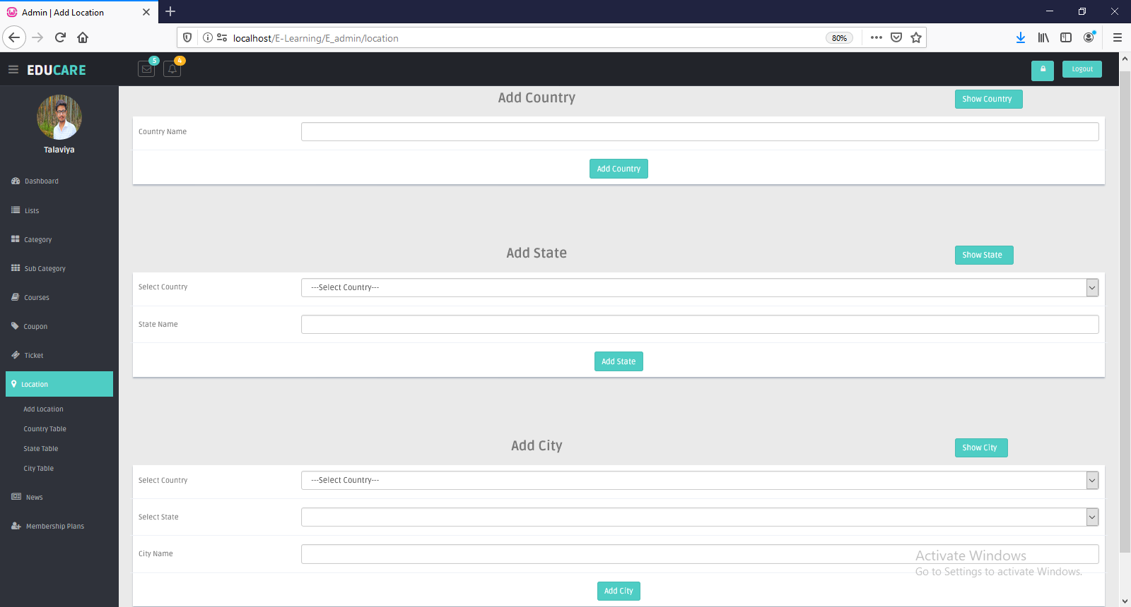
Admin CAN ADD LOCATION
user interface

Slide 51
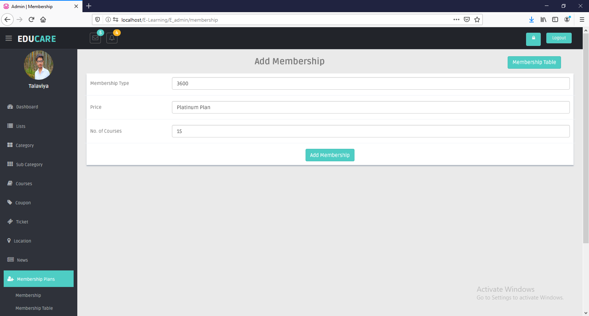
Admin can ADD MEMBERSHIP
user interface

Slide 52
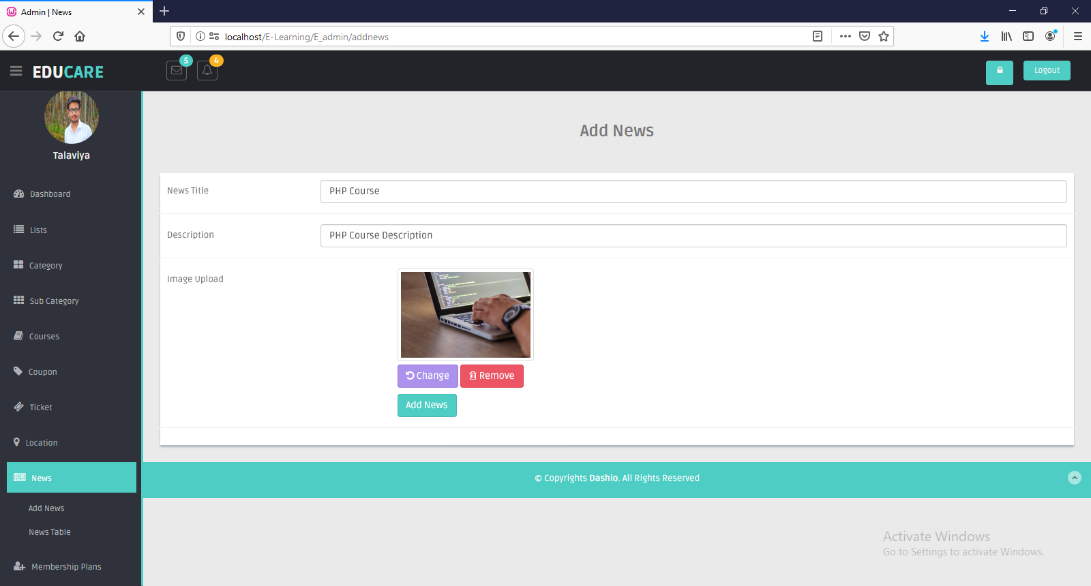
Admin SIDE ADD NEWS
user interface

Slide 53
FUTURE ENHANCEMENT
After the positive response of the student, tutor we will try to do that, what the student really wants from us.
We will add some general knowledge concept which is totally free, it will help students who want to give competitive exam.
We will try to give live video classes to all enrolled students.
We will provide payment to faculty for courses.

Slide 54
Online Education has brought a positive impact in the lives of students and working professionals. It has given an opportunity to take up additional courses along with their studies or job as per their convenience.
Online education has also helped the faculty in the institutions to ask students to study some part of syllabus online which do not require much of classroom instructions. So the online study helps the faculty to save time in which they can interact with the students more.
CONCLUSION

Slide 55

REFERENCE
https://www.w3schools.com/php/
https://www.udemy.com/
https://unacademy.com/
https://www.hostinger.in/tutorials/codeigniter-tutorial/
https://codeigniter.com/
https://www.coursera.org/

Slide 56

THANK
YOU

